Slide 1
THE DIFFERENT TYPES OF BUSINESS OWNERSHIP

Slide 2
STATE STANDARD
(Insert your state standard here)

Slide 3
STUDENTS WILL…
Identify the advantages and disadvantages of sole proprietorships, partnerships and corporations.

Slide 4








Most of the famous companies in the world started out small and changed their ownership structure as they grew.

Slide 5
WHY LEARN ABOUT BUSINESS OWNERSHIP?
You might own your own business someday, and you need to know which ownership options best suit your needs and meet your goals.
You can classify the different types of businesses you visit based on their ownership.

Slide 6

KNOW YOUR OPTIONS
Business Ownership Options Include:
  Sole Proprietorship
  Partnership
  Corporation
  Hybrid
  Franchise

Slide 7
KNOW YOUR OPTIONS
Know the advantages and disadvantages of each form of ownership.
Your choice of ownership can affect taxation and government involvement.

Slide 8
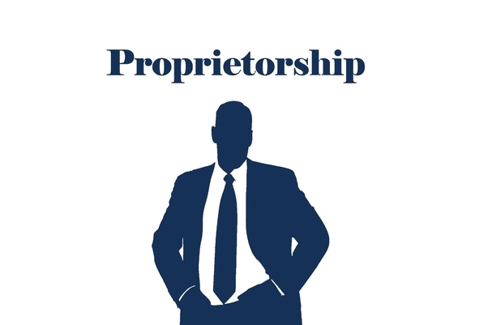
SOLE PROPRIETORSHIP
A business owned and operated by one person.
The owner is responsible for all operations of the business and assumes all the risk.

Slide 9
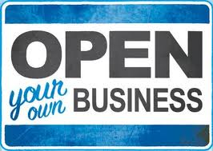
ADVANTAGES OF A SOLE PROPRIETORSHIP
Owner makes all decisions
Owner is her or her own boss
Owner keeps all the profits
All financial information can be kept secret
This type of business is easy to start or close
Flexibility
Tax Advantages
Ability to act quickly and make decisions

Slide 10
DISADVANTAGES OF A SOLE PROPRIETORSHIP
Owner has responsibility for all debts
Costs and time commitment can be high
Funding can be difficult to obtain
Owner is responsible for all aspects of the business
Owner doesn’t have fringe benefits provided

Slide 11
HOW TO START
Sole Proprietorship-no special forms to file other than obtaining local business license & permits

Slide 12

PARTNERSHIP
A form of business organization in which two or more people own and operate the business together

Slide 13

ADVANTAGES OF A PARTNERSHIP
Partners co-own the business
Combined resources
They share responsibilities
They may have greater financial resources than sole proprietors
They share business losses
They share time commitment
Tax advantages
Decreased competition

Slide 14
DISADVANTAGES OF A PARTNERSHIP
Partners have unlimited personal liability for all the other partners
Partners may have conflicts
Profits are shared
Partnerships are more difficult to close down than sole proprietorships
Uncertain life/transferability
If one partner makes a mistake, all partners are responsible

Slide 15
HOW TO START
Partnership-obtain proper business licenses & draw up a partnership agreement that includes the following:
  Capital contributions
  Responsibilities of each partner
  Decision making process procedures
  Shares of profits/losses
  Departure of partners
  Addition of partners

Slide 16
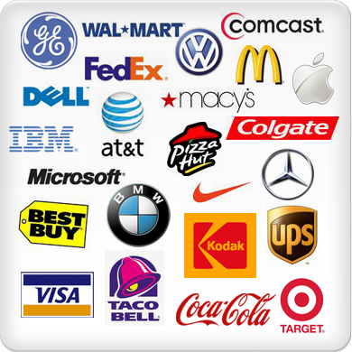
CORPORATION
A legal entity that exists independently of its owners
Owners are called shareholders

Slide 17
ADVANTAGES OF A CORPORATION
The owners are shareholders. They have limited liability for the debts of the corporation and share the profits
Usually shareholders do not operate the company – they hire employees to do so
Corporations can usually raise funds more easily than sole proprietors or partners

Slide 18
ADVANTAGES OF A CORPORATION
Corporations usually have a lower tax rate than private owners
A corporation can continue to exist after the death of its owners
Easy to transfer ownership to another party

Slide 19
DISADVANTAGES OF A CORPORATION
More difficult to form and operate
More government involvement
Corporations have more complicated structures than sole proprietorships or partnerships
Employees who are not owners may not be committed to the business
Separate owners and managers

Slide 20
DISADVANTAGES OF A CORPORATION
Dual taxation
Corporations must publish annual reports, which could give away important secrets to competitors
The value of company shares can change depending on changes in the stock market

Slide 21
HOW TO START
Corporation- must file Articles of Incorporation with the state in which they are organized and operate by the laws of that state (help from an attorney is a wise choice!)
  Articles of Incorporation is a legal document that defines ownership and operating procedures and conditions for the business
  Business must create corporate bylaws (operating procedures)
  Business must name a board of directors (people who make the major policy and financial decisions for the business.)

Slide 22
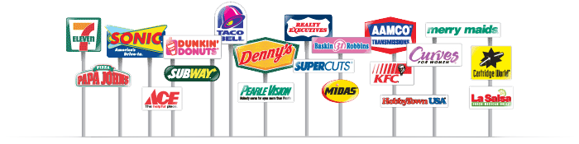
FRANCHISE
A business in which a franchisor sells to another person, called the franchisee, the rights to use the business name and to sell a product or service in a given territory

Slide 23
ADVANTAGES OF A FRANCHISE
Franchisees buy a business with a good reputation
Franchisors supply training and financial knowledge
Franchisors usually provide packaging, advertising, and equipment to the franchisee

Slide 24
DISADVANTAGES OF A FRANCHISE
Franchises can be expensive to buy
Franchisees may have to follow a lot of rules laid down by the franchisors
If a franchisor’s business fails, so will the franchisee’s business

Slide 25
HOW TO START
Generally franchisor will interview the franchisee and there will be an application process. Not every application gets approved!
Sign the franchise agreement and make your investment.
Typically franchise agreements last 5-10 years and must be renewed if the franchisee wants to continue running the franchise.

Slide 26
HOW DO YOU DECIDE WHICH FORM IS BEST FOR YOU?
https://www.youtube.com/watch?v=A-Up-JUkaj0

Slide 27
ON YOUR OWN…
Do your own research to see what information you can find about the following hybrid forms of business ownership!
-Hybrid=means a mix of more than one form
  Limited Liability Corporation (LLC)
  S Corporation
  Limited Liability Partnership

Slide 28
DISCUSSION QUESTION
Why are LLC’s, S Corps, and LLP’s considered hybrid forms of business ownership? What do they combine from each form?

